Slide 2
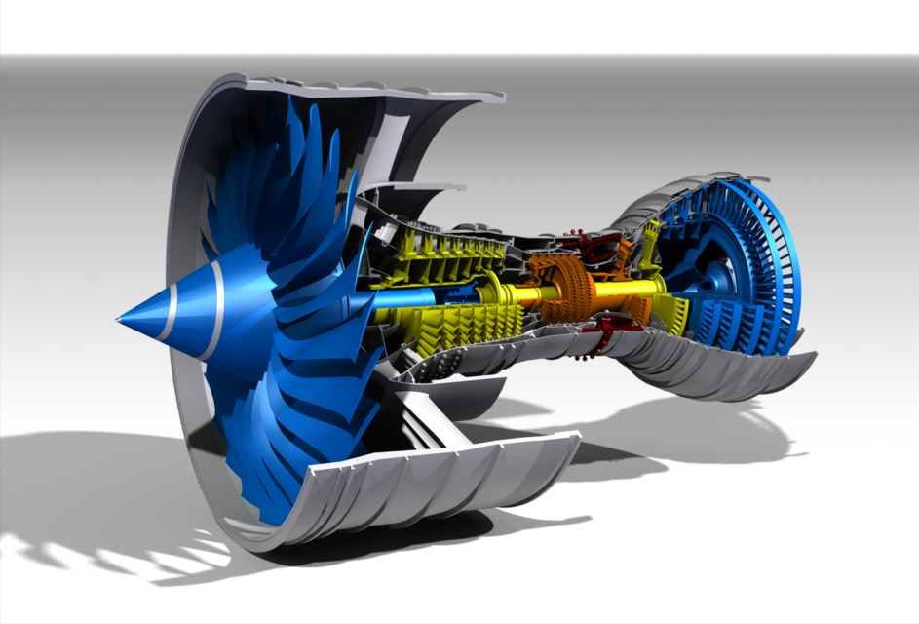
Source: grabcad.com

Slide 3
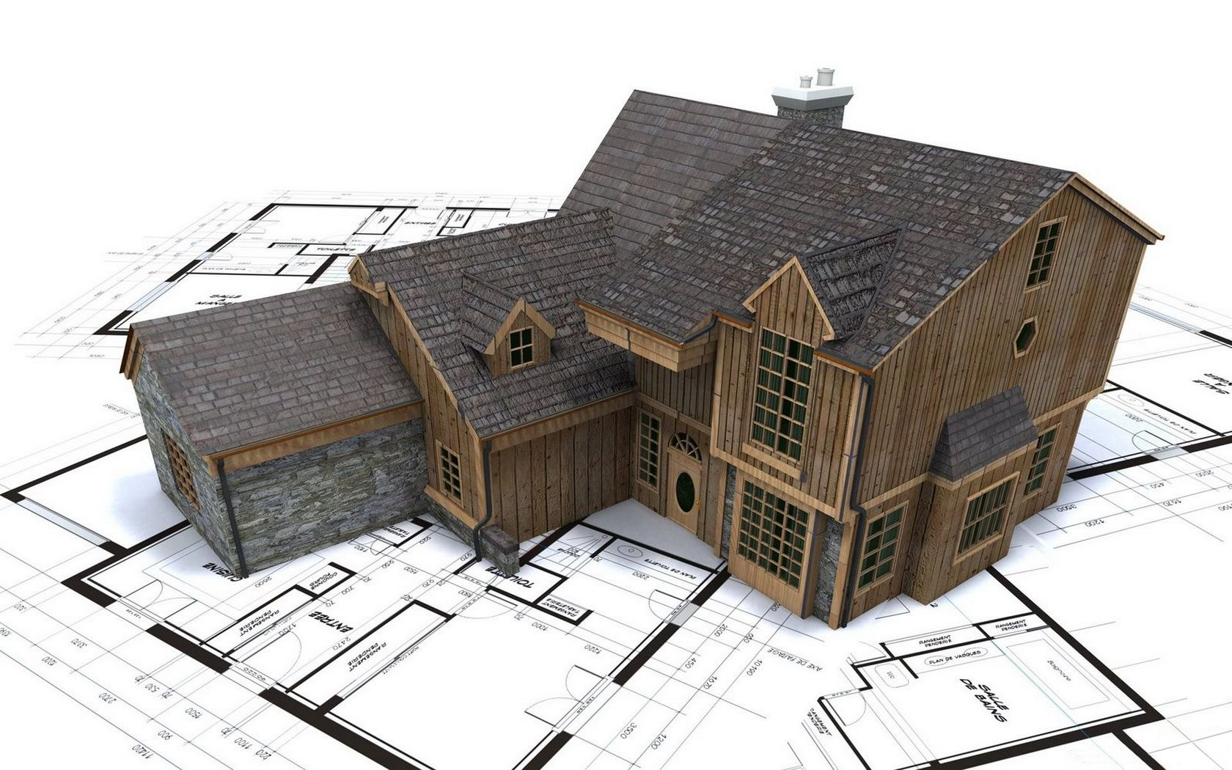
Source: wallpaperup.com

Slide 4
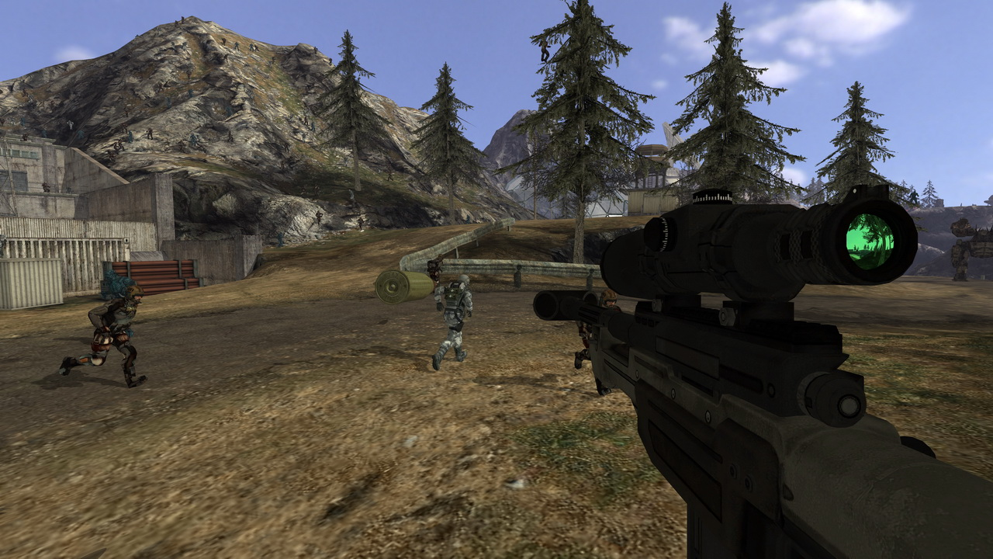
Source: Quake Wars: Ray Traced, Wikipedia

Slide 5
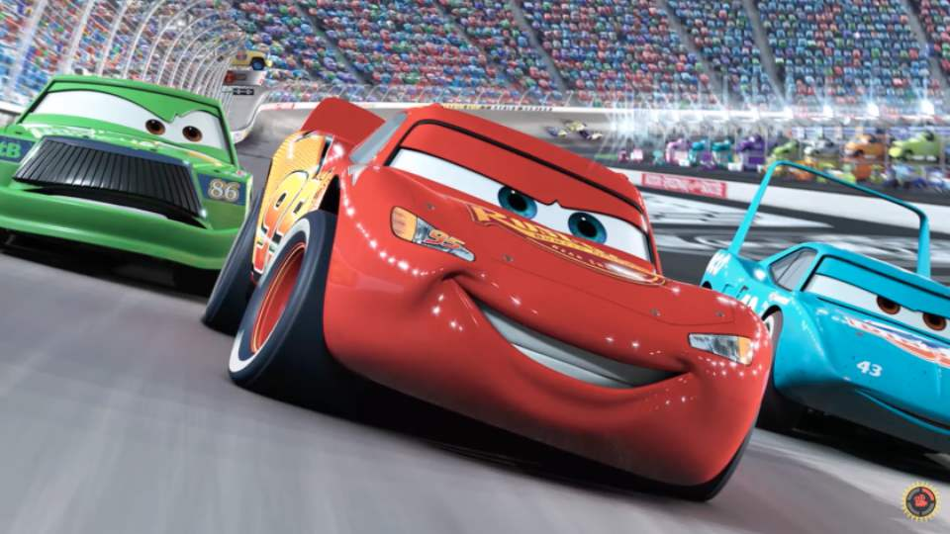
Source: Cars, Pixar, Wikipedia

Slide 6
Source: Quake Wars: Ray Traced, Wikipedia

Slide 7
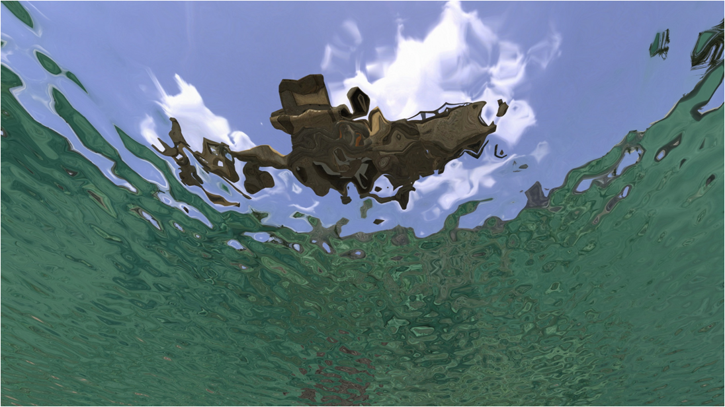
Source: Quake Wars: Ray Traced, Wikipedia

Slide 8
Source: Cars, Pixar, Wikipedia

Slide 9
Source: Cars, Pixar, Wikipedia

Slide 10
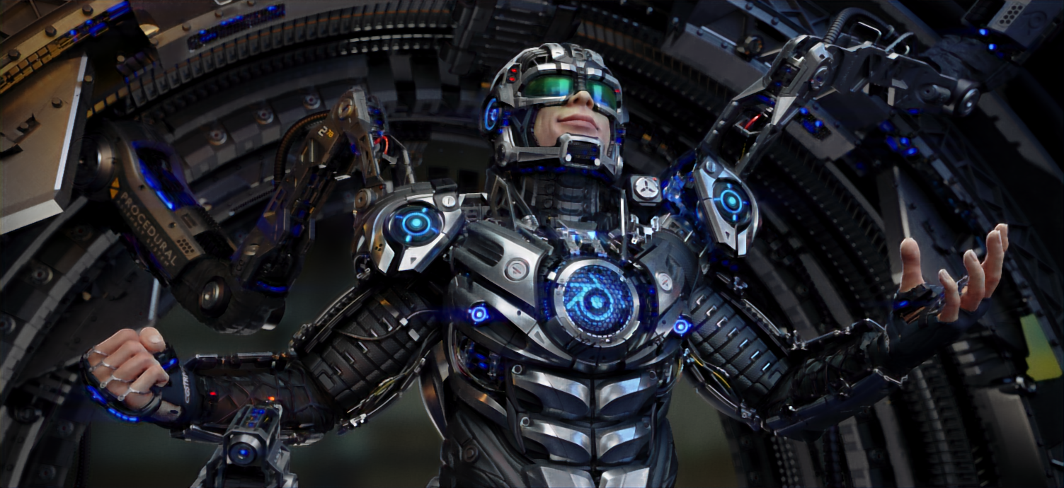
Source: Juri Unt (Artist), Zichen Liu (Renderer), airenderer.com

Slide 11
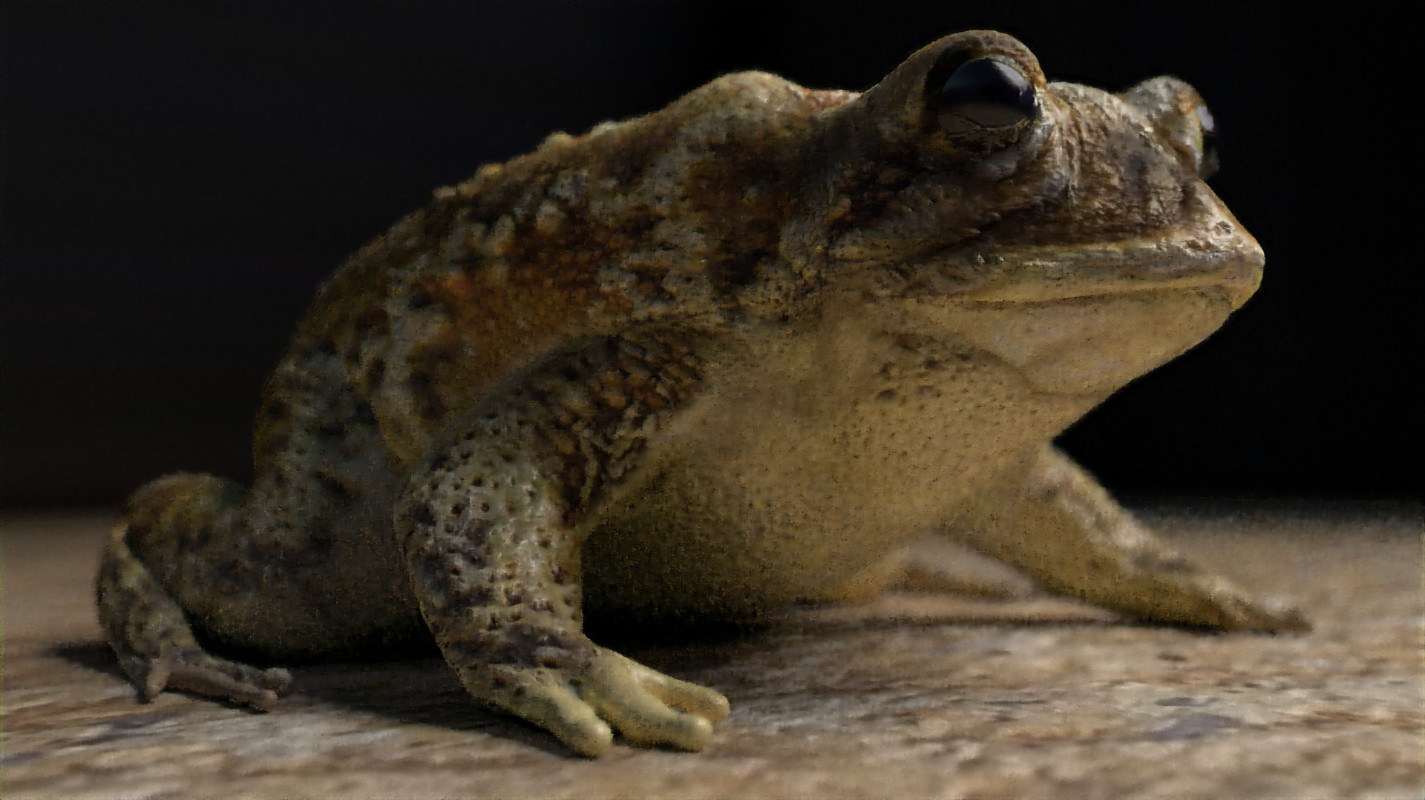
Source: arenyart (Artist), Zichen Liu (Renderer), airenderer.com

Slide 12
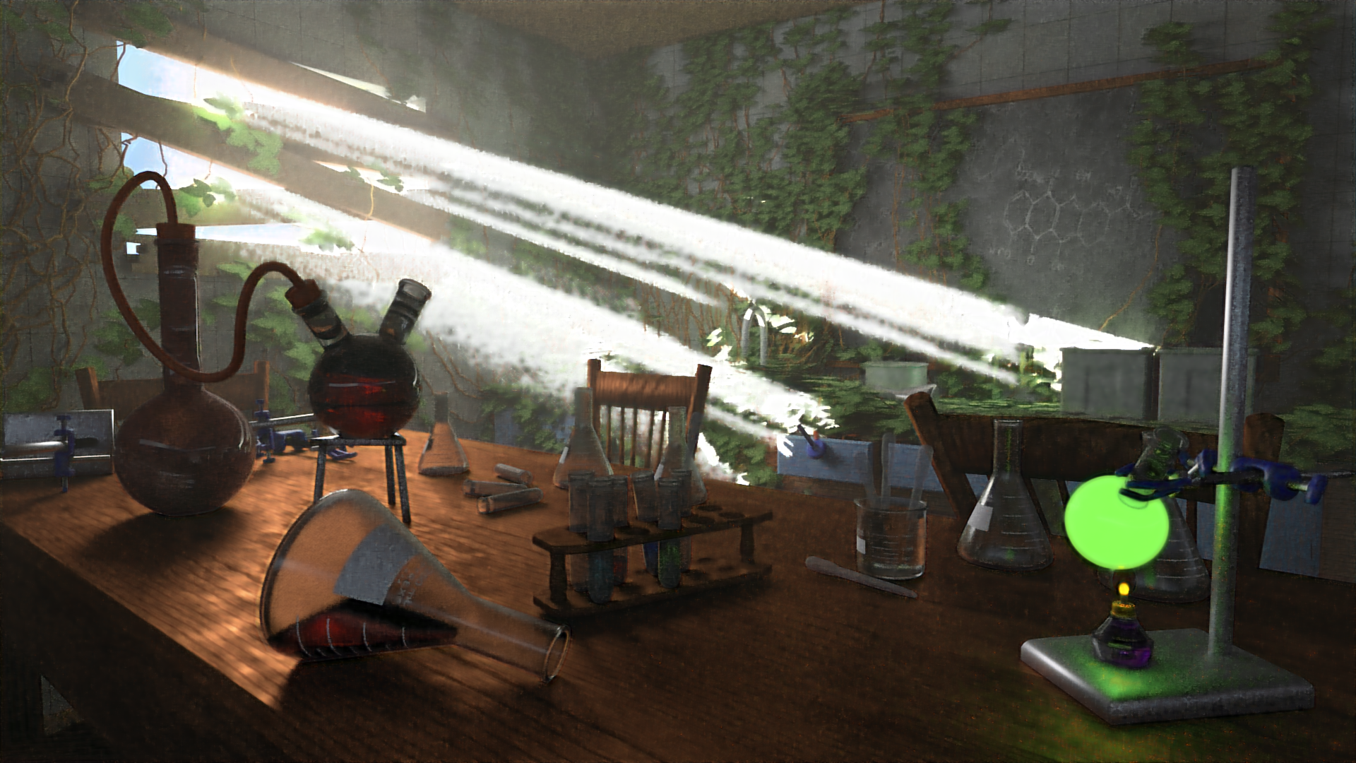
Source: Elysia (Artist), Zichen Liu (Renderer), airenderer.com

Slide 13
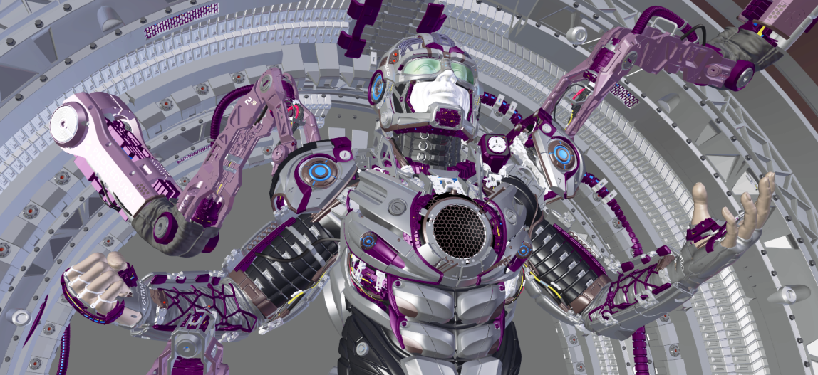
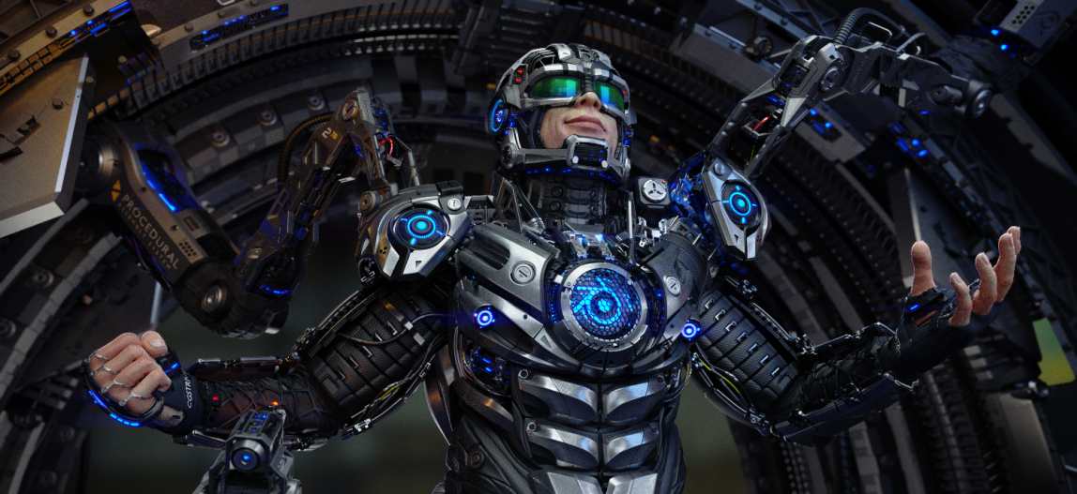
Source: Juri Unt (Artist), Zichen Liu (Renderer), airenderer.com

Slide 14
Spec
Ray tracer
Noisy Image
Ray tracer
Clean Image
Approx. 1 min
Approx. 1 hour

Slide 15
Ours
Approx. 2 mins
Spec
Ray tracer
Noisy Image
Ray tracer
Clean Image
Approx. 1 min
Approx. 1 hour

Slide 16

Source: Juri Unt (Artist), Zichen Liu (Renderer)

Slide 17
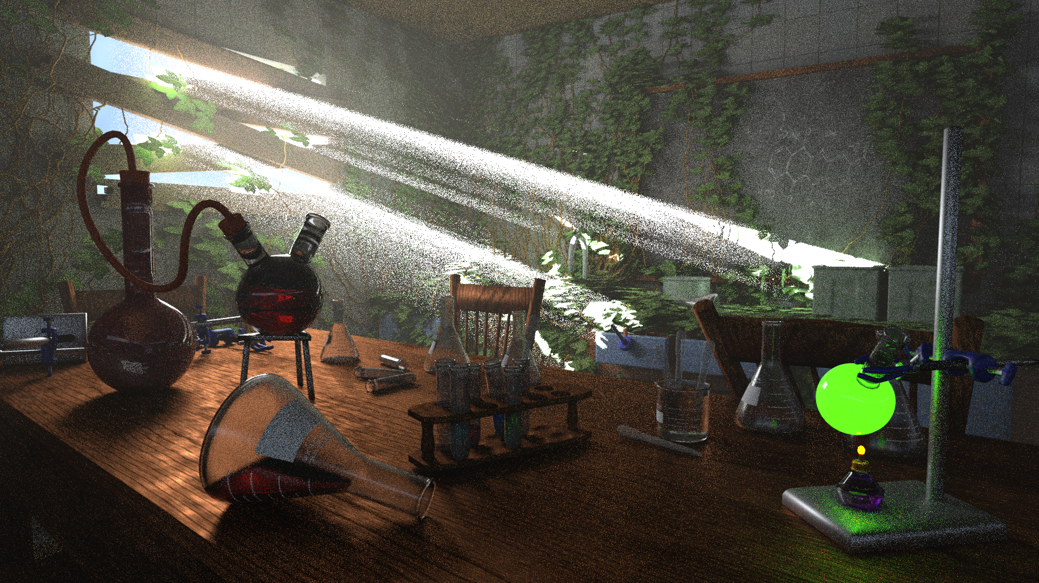
Source: Elysia (Artist), Zichen Liu (Renderer)

Slide 18
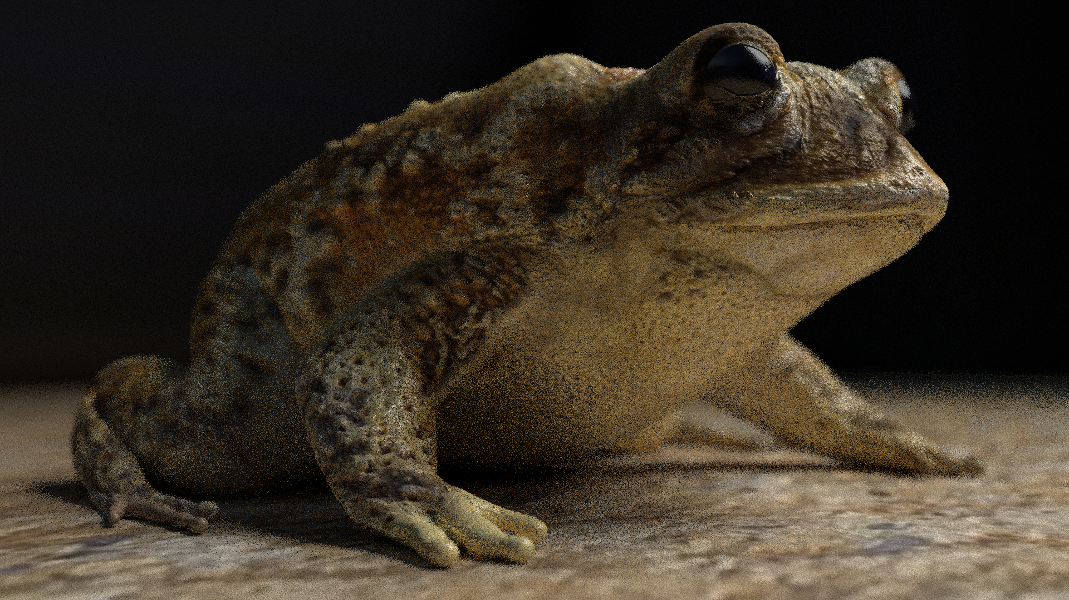
Source: arenyart (Artist), Zichen Liu (Renderer)

Slide 19
Source: Juri Unt (Artist), Zichen Liu (Renderer), airenderer.com

Slide 20
Noisy
Ours
Source: Juri Unt (Artist), Zichen Liu (Renderer)

Slide 21

Ray traced
Ours
Source: Juri Unt (Artist), Zichen Liu (Renderer)

Slide 22
Ours
Spec
Ray tracer
Noisy Image
Ray tracer
Clean Image
Ray tracer
40 minutes
Ours
2 minutes

Slide 23
Source: arenyart (Artist), Zichen Liu (Renderer), airenderer.com

Slide 24
Source: arenyart (Artist), Zichen Liu (Renderer)

Slide 25
Ours
Spec
Ray tracer
Noisy Image
Ray tracer
Clean Image
Ray tracer
14 minutes
Ours
2 minutes

Slide 26
Source: Elysia (Artist), Zichen Liu (Renderer), airenderer.com

Slide 27
Source: Elysia (Artist), Zichen Liu (Renderer)

Slide 28
Ours
Spec
Ray tracer
Noisy Image
Ray tracer
Clean Image
Ray tracer
120 + ? minutes
Ours
2 minutes

Slide 29
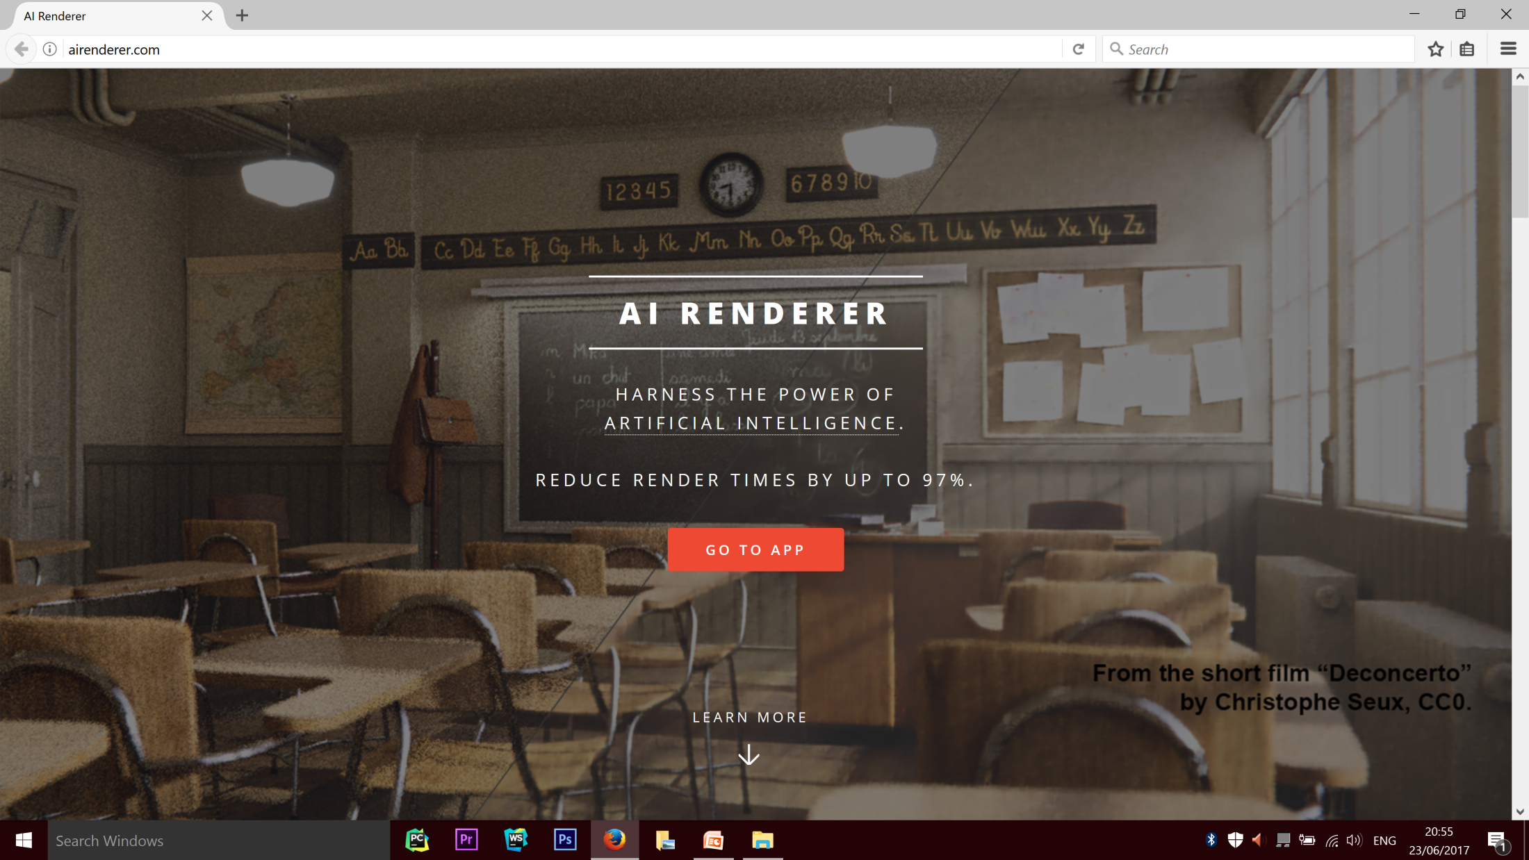

Slide 30
1000+
visits

Slide 31
108
app uses

Slide 32
26
ratings left

Slide 33
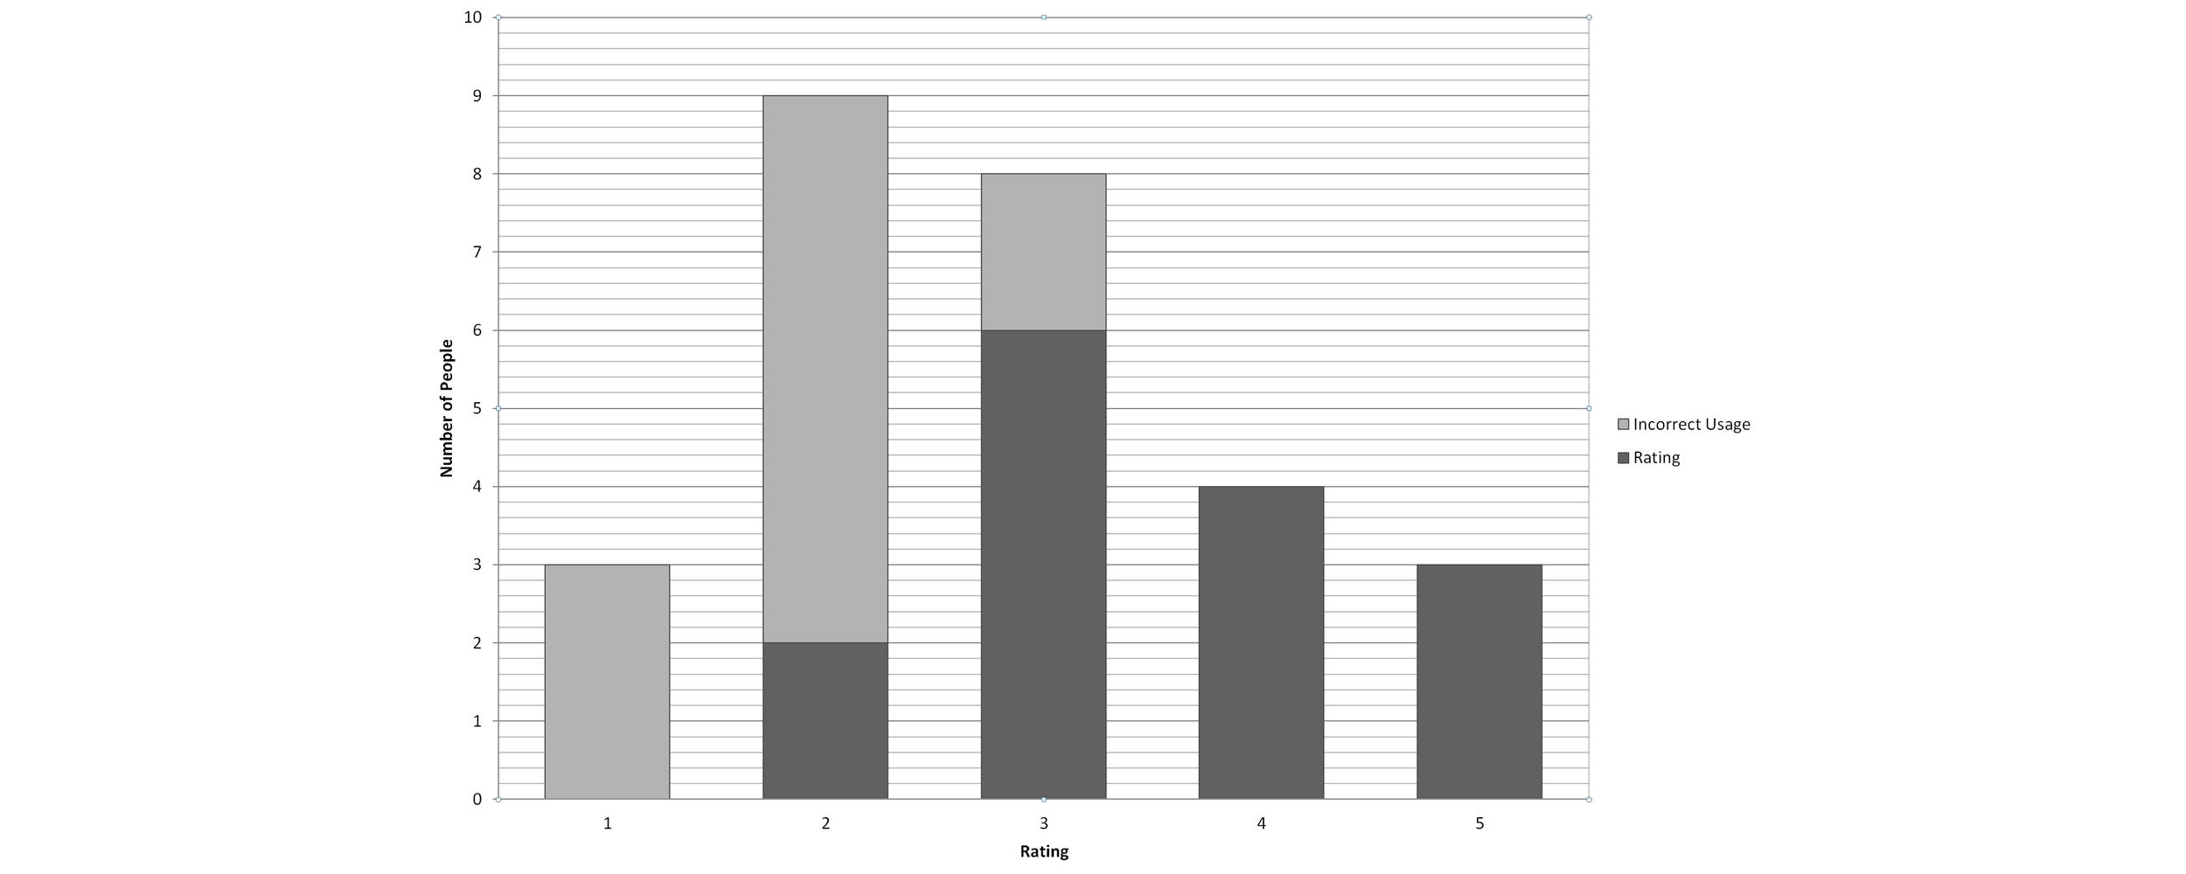

Slide 35
50 million
training examples
30 million
test examples
150+
models tested

Slide 36
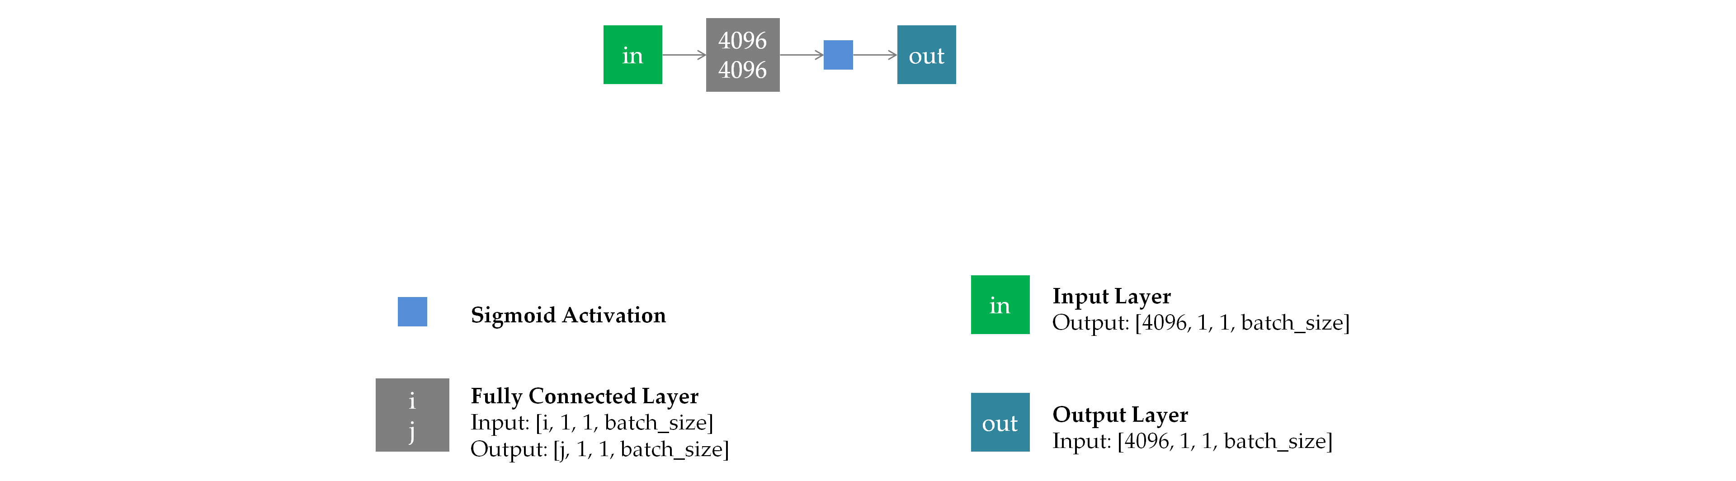

Slide 37
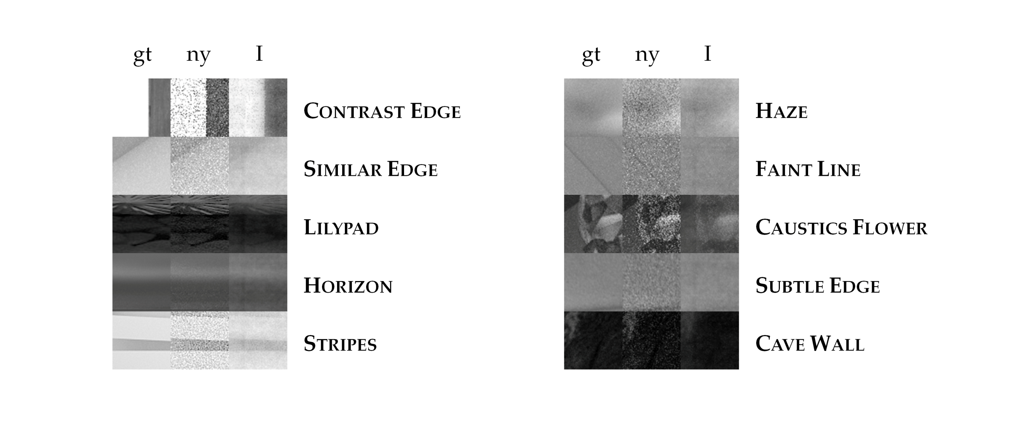

Slide 38
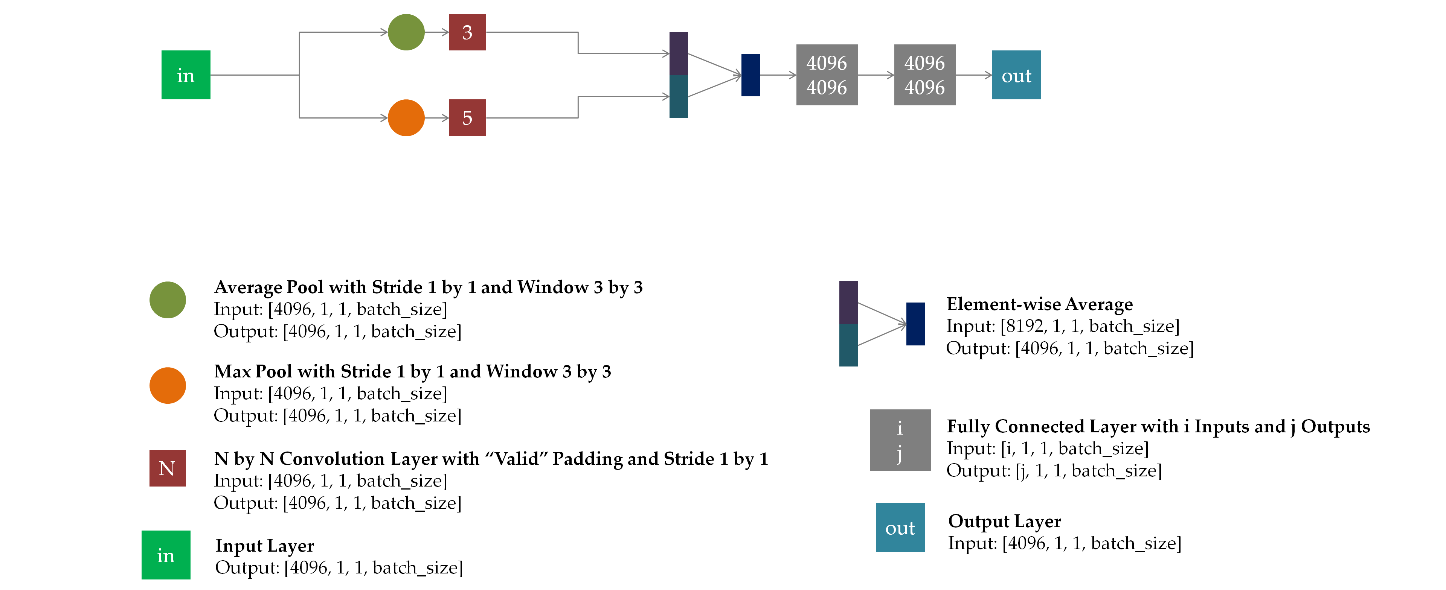

Slide 39
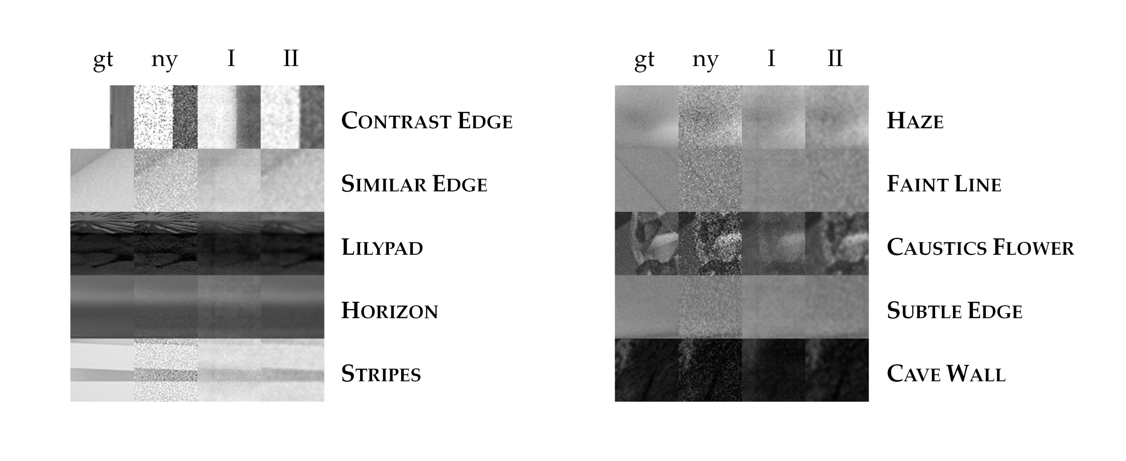

Slide 40
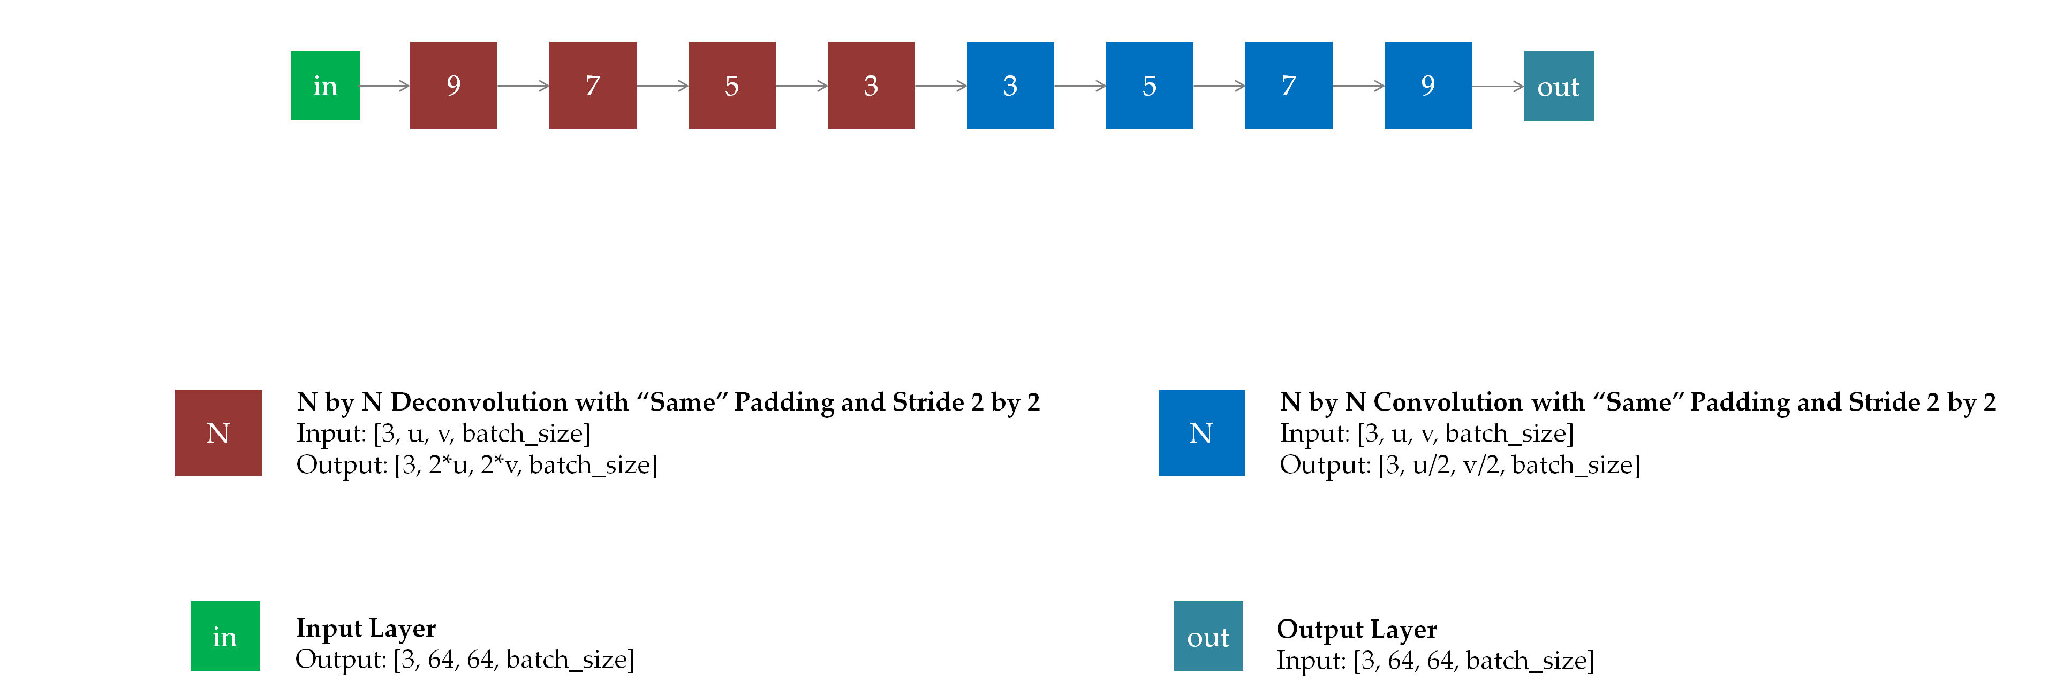

Slide 41
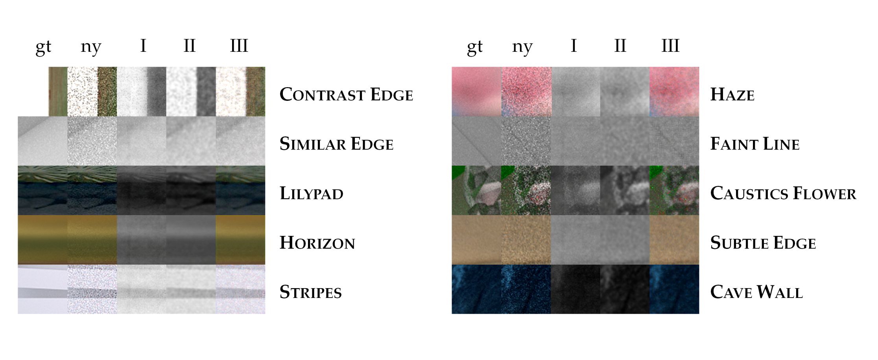

Slide 42
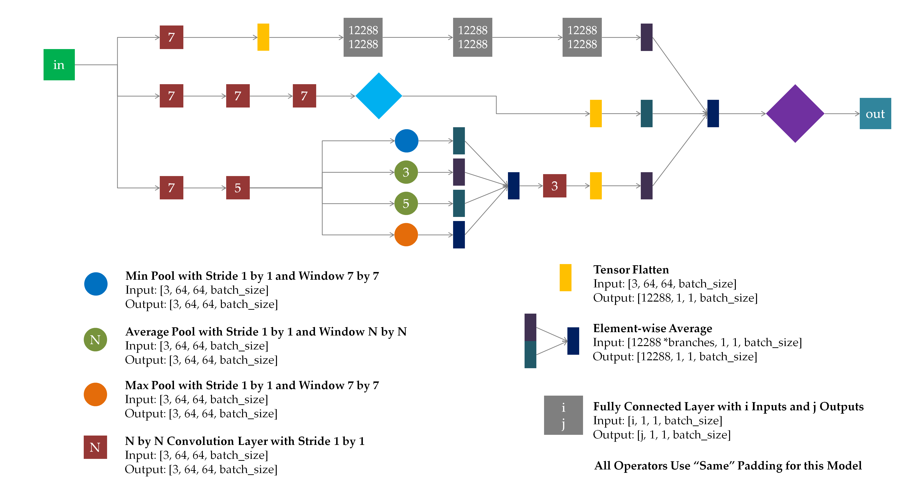

Slide 43
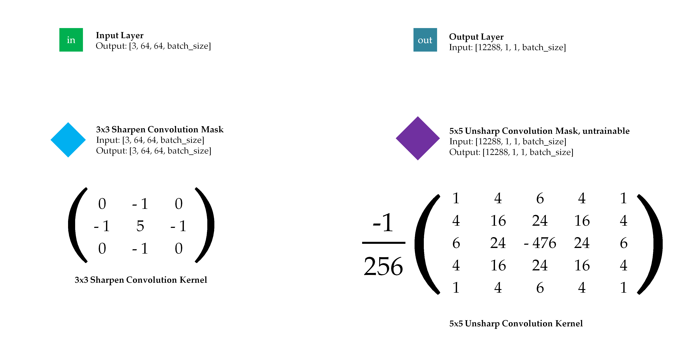

Slide 44
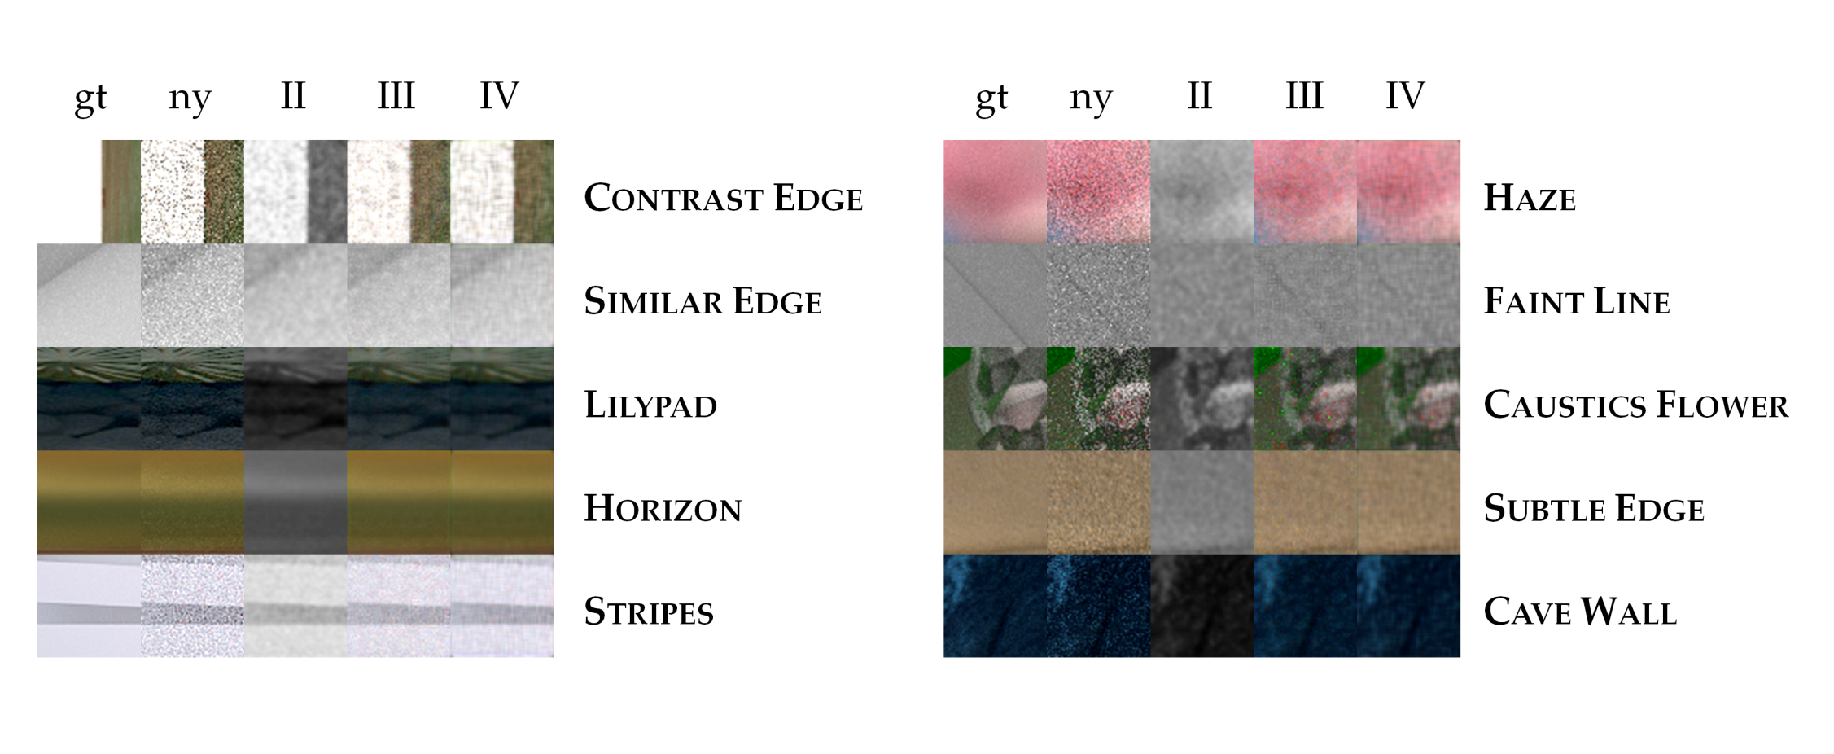

Slide 45
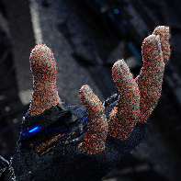
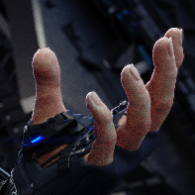
Neural Network
64
64
64
64

Slide 46
Central Pixel of Patch is Designated Output
Neural Network
31
1
1
31

Slide 47
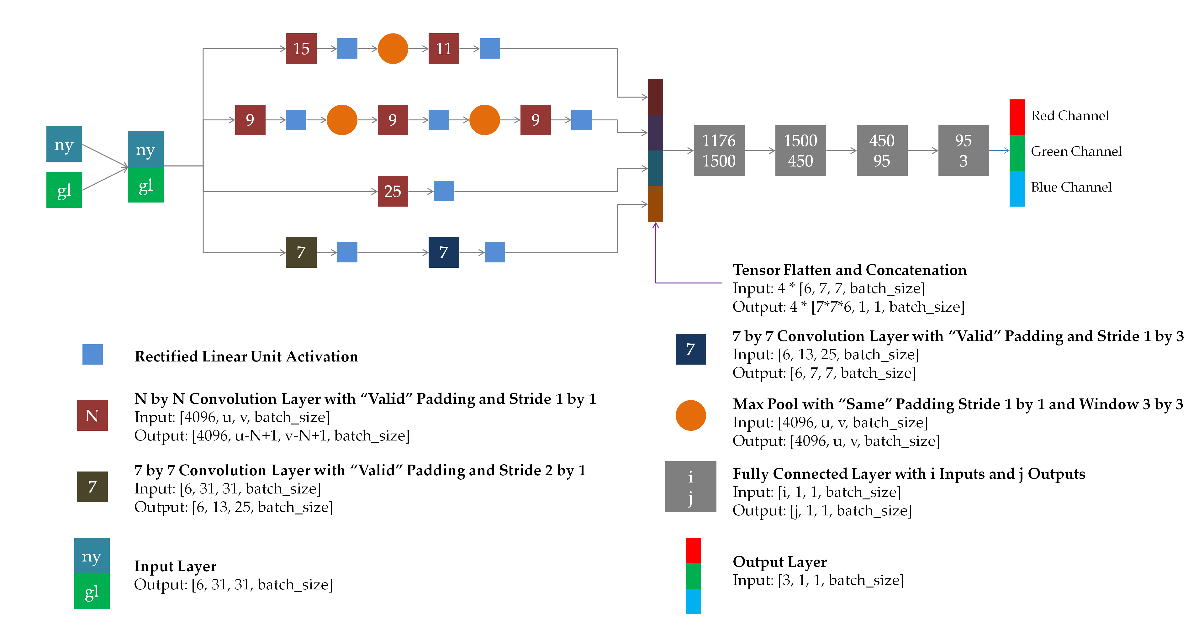

Slide 48
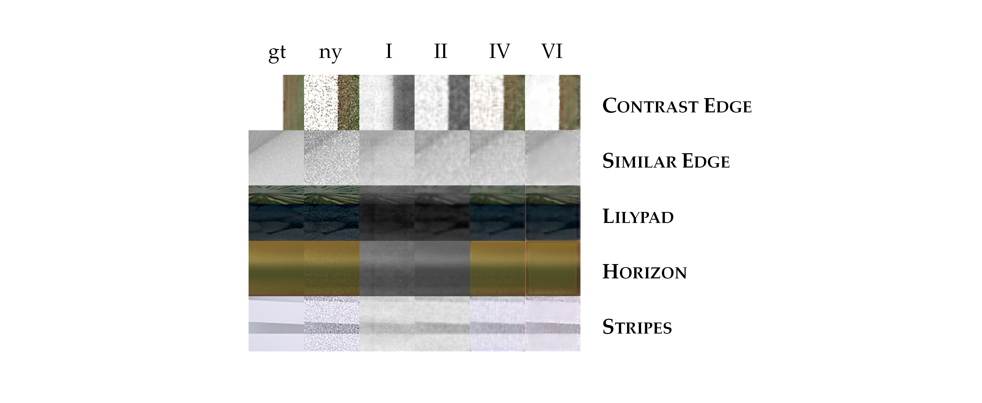

Slide 49
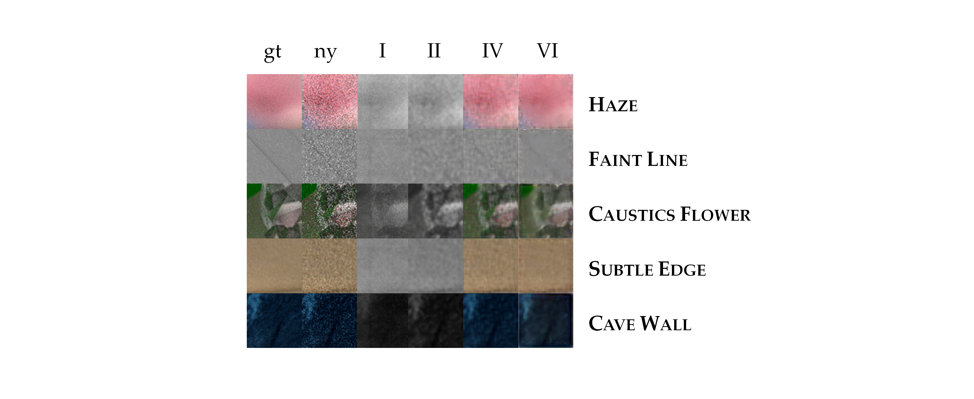

Slide 51
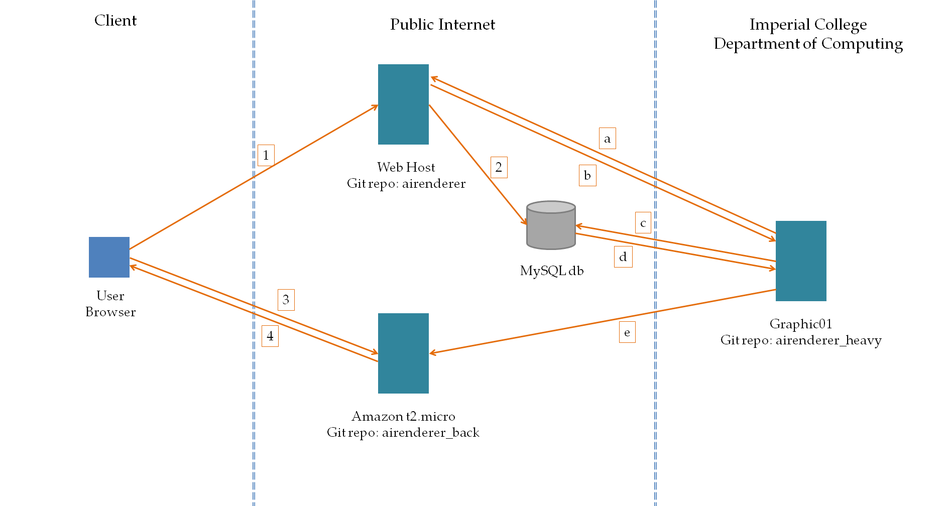

Slide 52
